Slide 1

Problem Solving with the Internet of Things and Python
Douglas C. Burhanna, Candidate
Advisor: Dr. Kenneth Loparo, Advisor
Department of Electrical, Computer and Systems Engineering
May 24, 2022

Slide 2
Outline
Motivation
Objectives
Curriculum Development
The Curriculum
Contributions

Slide 3
Motivation
About me

Slide 4
Motivation
About me → Teaching

Slide 5
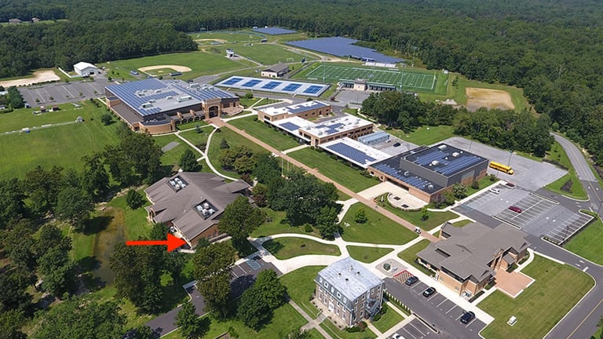
St. Augustine Preparatory School

Slide 6
Motivation
About me → Teaching → A Curriculum?

Slide 7
Motivation
Programming is Problem Solving
The Internet of Things

Slide 8
Objectives
1 - Design a detailed modular curriculum.

Slide 9
Objectives
1 - Design a detailed modular curriculum.
2 - Identify, synthesize and evaluate the necessary IoT
components.

Slide 10
Objectives
1 - Design a detailed modular curriculum.
2 - Identify, synthesize and evaluate the necessary IoT
components.
3 - Provide a method of curriculum distribution.

Slide 11
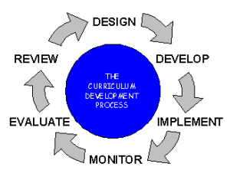
Curriculum Development
Note: from educationalcareerjournal.com, n.d.

Slide 12
Curriculum Development
“Problem Solving”
Python

Slide 13
Curriculum Development
“Computational Thinking”
Decomposition
Pattern Recognition
Abstraction
Algorithmic Thinking
Evaluation

Slide 14
Curriculum Development
“Experiential Learning”
Internet of Things

Slide 15
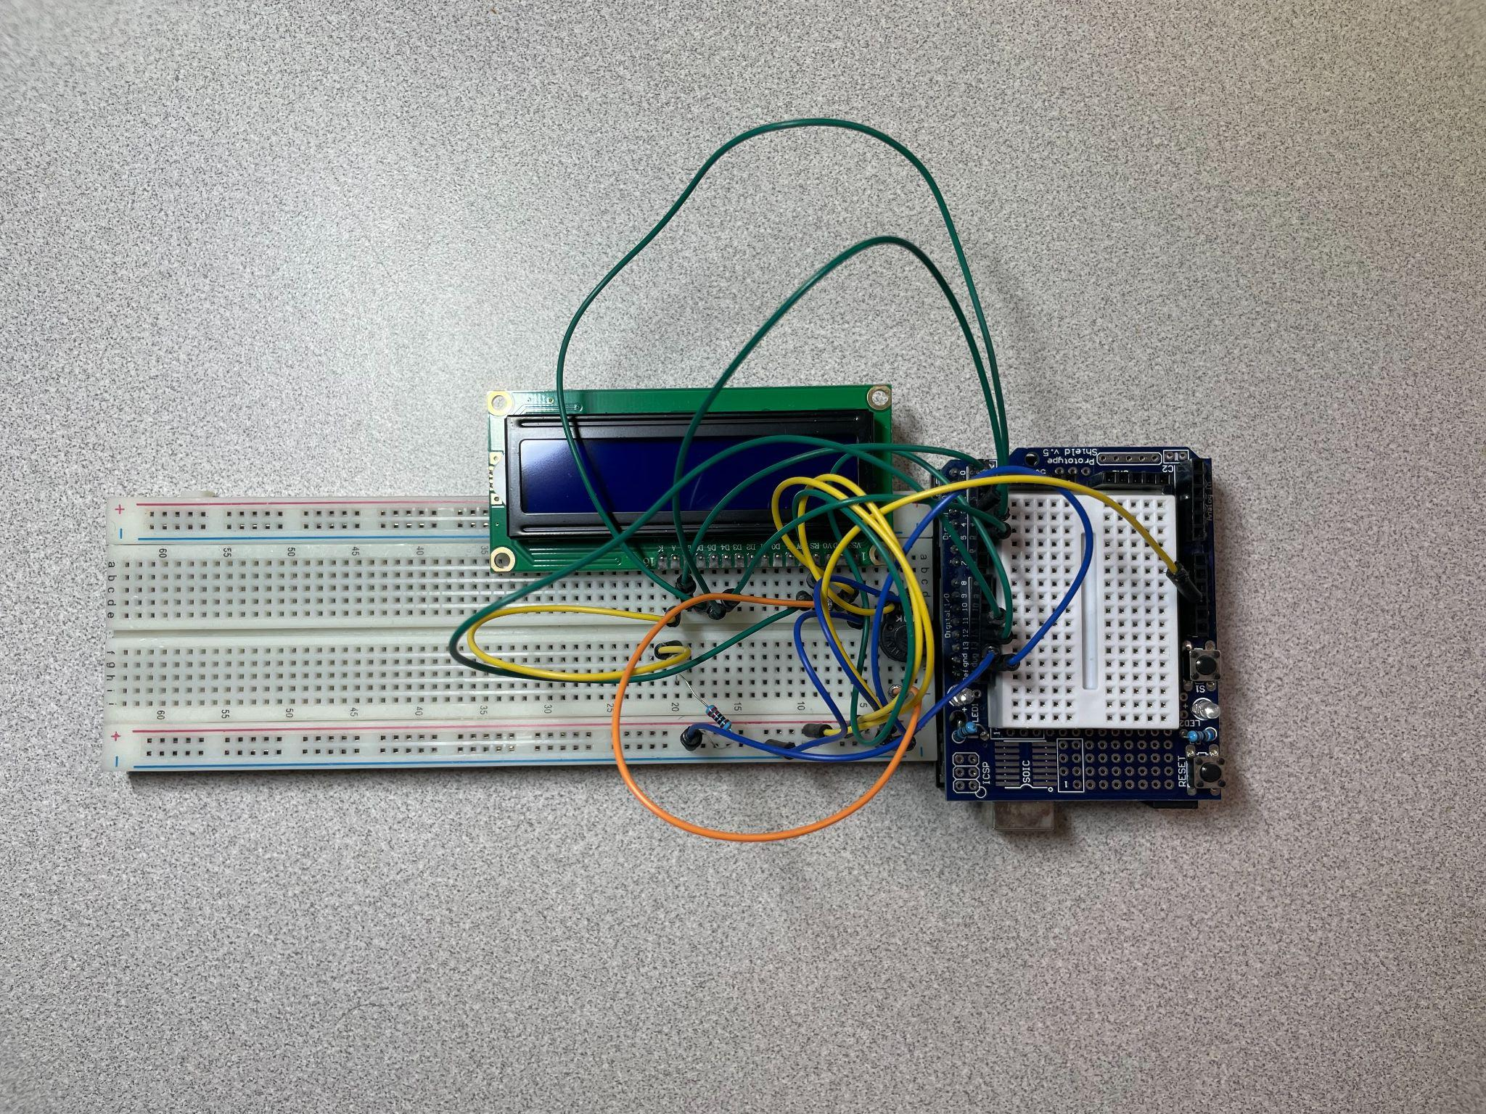

Slide 16
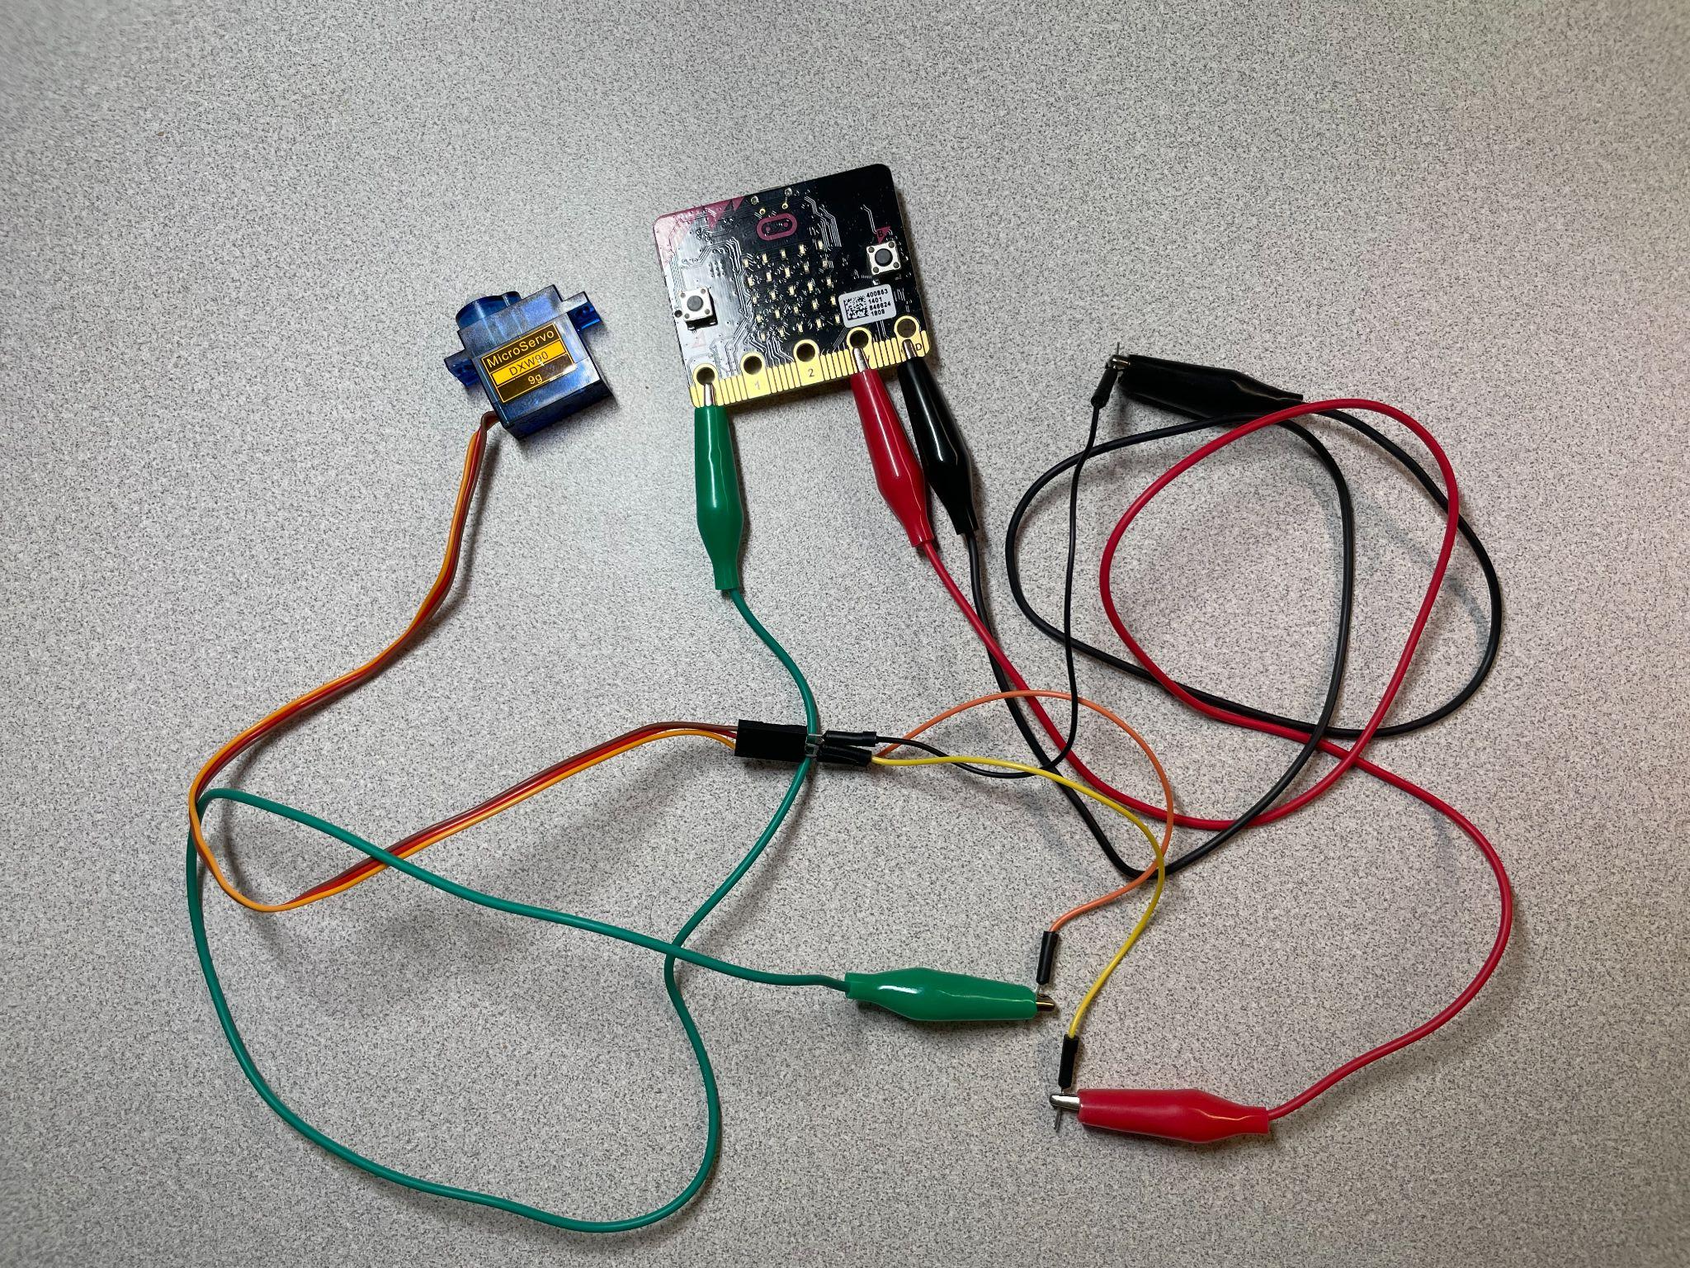

Slide 17
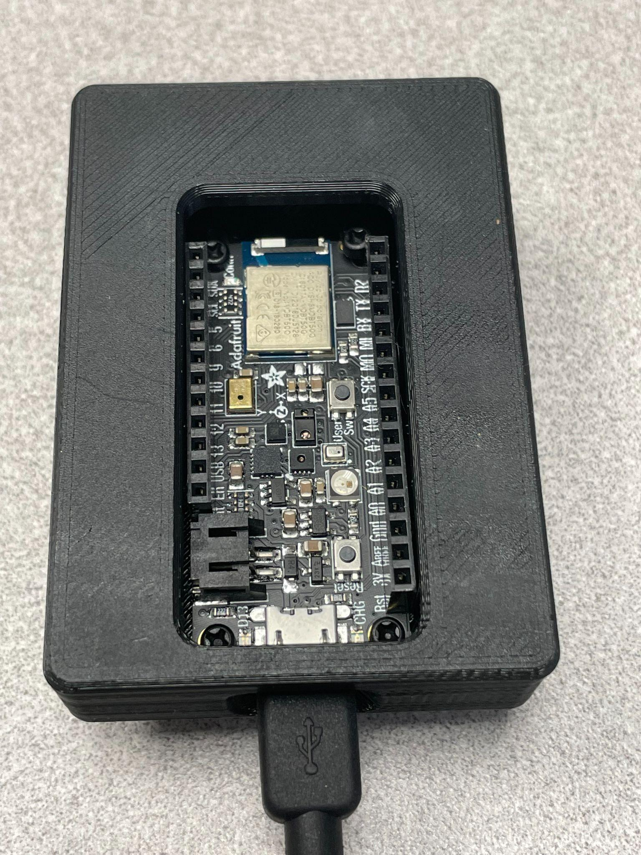
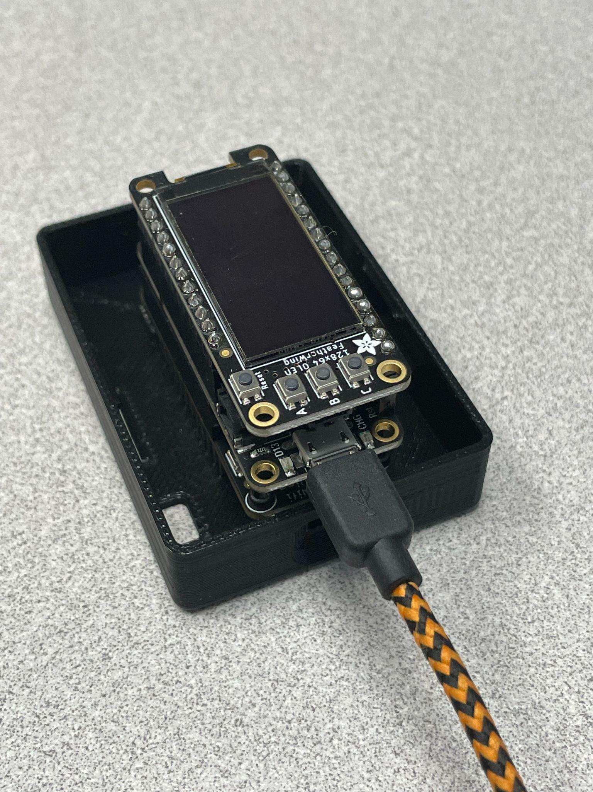

Slide 18
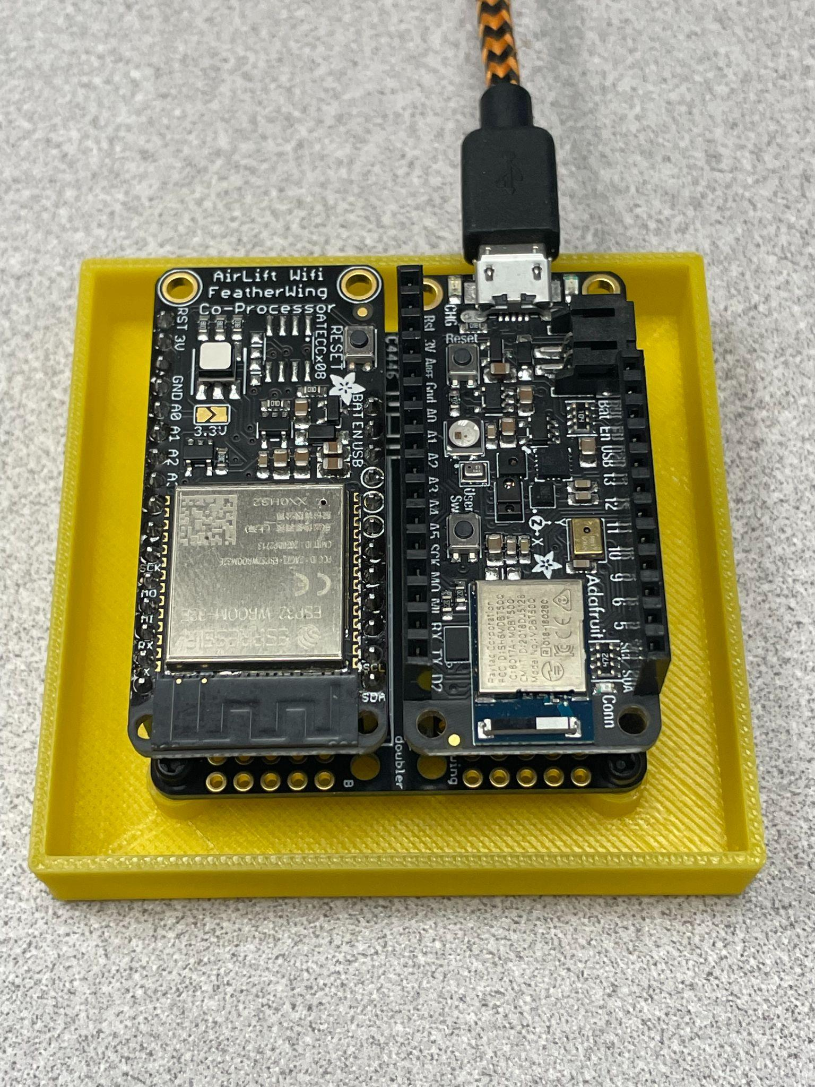

Slide 19
Curriculum Development
“Problem Solving”
“Computational Thinking”
“Experiential Learning”

Slide 20
The Curriculum
Unit 1 - Introduction to IoT
Unit 2 - Python Programming
Unit 3 - CircuitPython
Unit 4 - BLE Connectivity
Unit 5 - WiFi Connectivity
Unit 6 - Final Project

Slide 21
The Curriculum
Unit 1 - Introduction to IoT

Slide 22
The Curriculum
Unit 2 - Python Programming

Slide 23
The Curriculum
Basic Programming Abilities
Math
Inputs
Outputs
Make/Use Variables
Decisions - If/then
Loop

Slide 24
Python Lab Example

Slide 25
The Curriculum
Unit 3 - CircuitPython

Slide 26
CircuitPython Lab Examples

Slide 27
The Curriculum
Unit 4 - BLE Connectivity

Slide 28
BLE Lab Example

Slide 29
The Curriculum
Unit 5 - WiFi Connectivity

Slide 30
WiFi Lab Example

Slide 31
The Curriculum
Unit 6 - Final Project

Slide 32
Final Project Example

Slide 33
GitHub Demo

Slide 34
Contributions
1 - Designed a detailed modular curriculum.
2 - Identified the necessary components for an IoT
based curriculum.
3 - Provided a method of curriculum distribution.

Slide 35
Future Work
- Unit using LoRaWan Radio connectivity
- Powering IoT devices
- Simulate IoT hardware
- Dedicated website

